Slide 1
Speed Typing Test
Christopher Ringer, Sol Benishay, Milo Baker-Durante

Slide 2
Outline
Problem Description
Analysis and Design
Demonstration
Tests
Documentation
6) Tools
7) Challenges
8) Discussion
9) Contributions

Slide 3
Problem Description
Created a speed typing test
Given a random sentence, we wanted to be able to time how long it took for the user to copy it
Also wanted to be able to calculate their words per minute and the accuracy of their typing
Created one on Java and one on Python

Slide 4
Analysis & Design Steps
For Python we started off by designing the game to function without the use of a GUI. Once we created a working version of the game this way, we implemented GUI methods to make the game function with a GUI.
Some of the important steps in the python version were figuring out how to compare the likeness of two strings for our accuracy evaluation, as well as figuring out when and how to both start and stop the timer.
For Java, because we already had the Python version layed-out, we created the function of the game and the actual GUI together

Slide 5
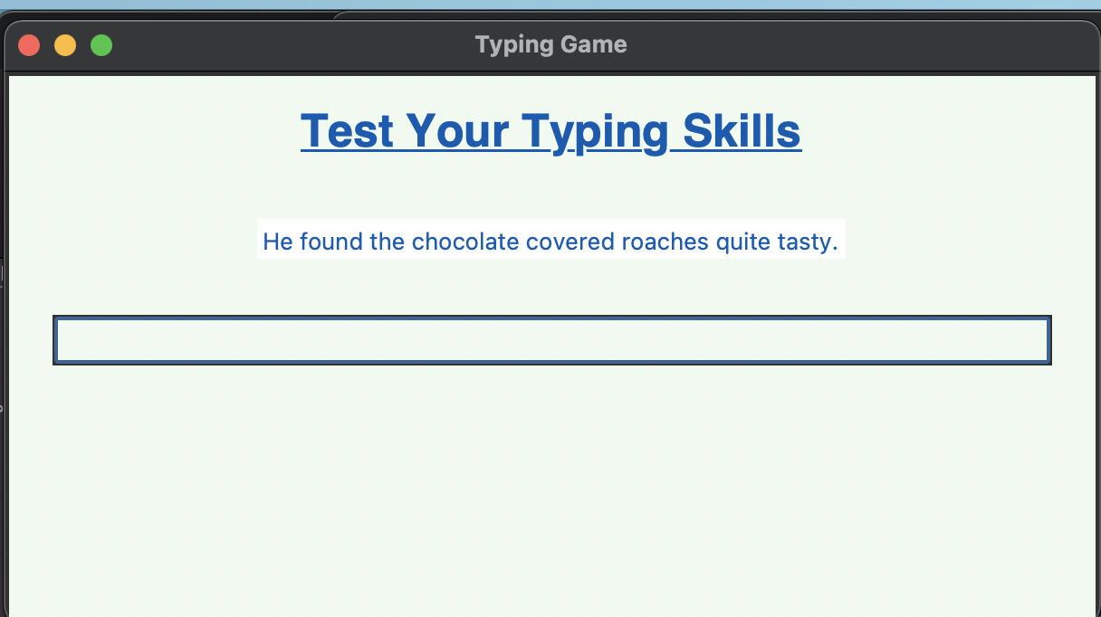
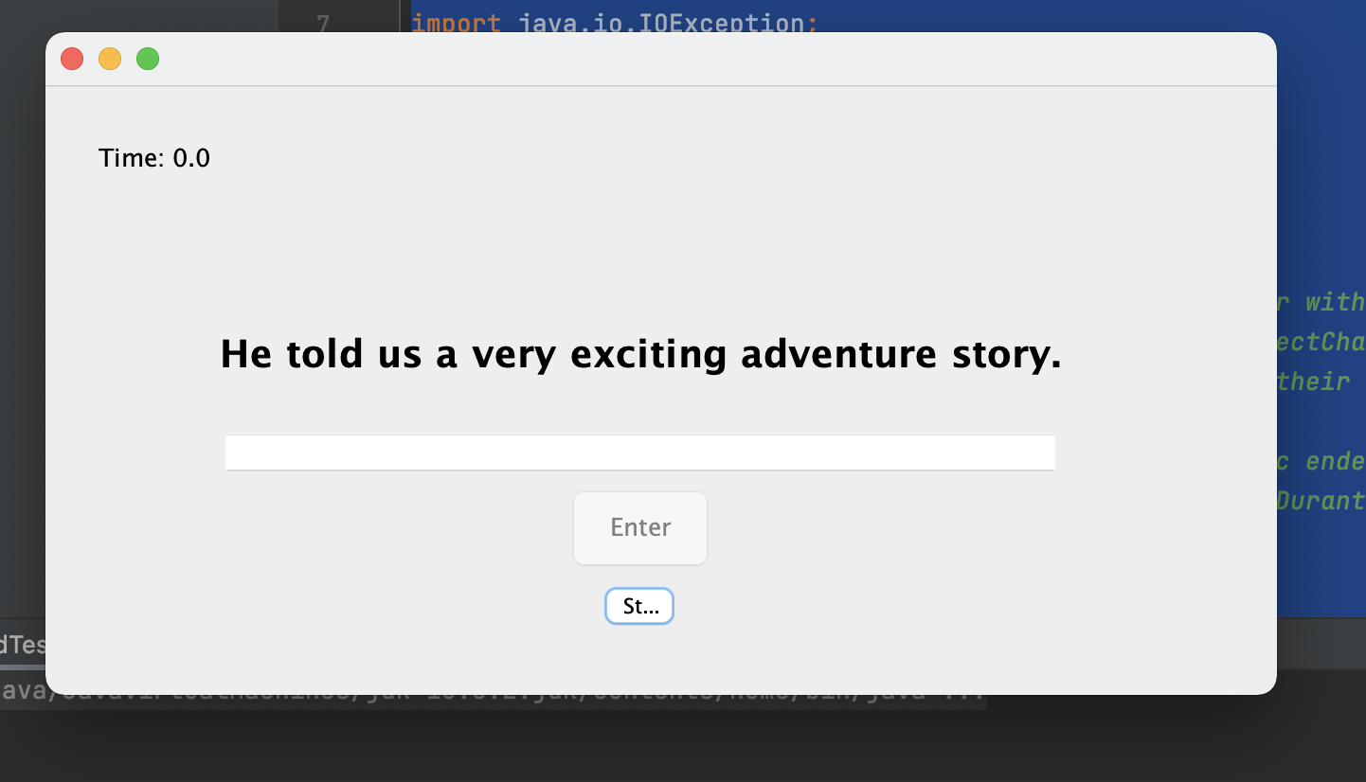
Demonstration of Basic Operations

Slide 6
Tests
Implementing automated testing was a bit of a challenge for our game as it is very dependent on the user’s unique input.
Issues would come up with our accuracy calculation if the user entered an input that was equal to, but had a greater number of characters than the text to copy down
Ex. To Copy = “Hello”, userInput = “Helloaaa”, accuracy = 100%
Because our accuracy calculation was not done perfectly, testing will yield incorrect results every time
Similarly, much of our outputs for result were dependent on the amount of time it took for the user to enter their sentence, and thus automated testing didn’t seem too applicable.

Slide 7
Documentation
Python version contains documentation for the functions
Java version contains Javadoc comments for the class (whole class is standalone program) and methods

Slide 8
Tools/Technology used in the Project
For Python, we used TkInter one of the most common and standard GUI packages, as well as timeit, a timer library.
For Java, Swing components were used for the GUI while some basic Java libraries were used for functionality (java.io, java.util, java.util.Scanner)
The Python project was built in PyCharm (Although didn’t require a project as a standalone script)
The Java project was built in IntelliJ

Slide 9
Limitations & Challenges
Huge challenge for both programs was determining the best ways to compare the two strings for accuracy, especially when the two strings do not match lengths.
One challenge for the Python part was learning the ins and outs of TkInter. Just like with any library it takes time to become familiar.
At least for the Python version, one limitation is in using the type of action commands that we used, if the user were to press shift in the middle of typing, their timer would restart, giving an inaccurate time and wpm.
For the Java, getting the hang of building the GUI using Java Swing took time and a lot of trial and error
Trying to create multiple game rounds and levels was tough

Slide 10
Discussion
We became much more comfortable implementing and using GUIs in both Python as well as Java
Helped us with learning how to outline and plan our program before implementing code
Will help make future projects easier and take less time to code
The process of implementing code to work without a GUI and then coding around it is definitely beneficial and something that should of been done for the Java version as well

Slide 11
Contributions
Christopher: Primarily worked on the Python implementation, helped out with Java design
Sol: Primarily worked on the Java implementation, helped out with Python design
Milo: Worked on both implementation and helped coordinate between the two

Slide 12
References
For Python:
https://realpython.com/python-gui-tkinter/
Amos, David. “Python GUI Programming With Tkinter.” Real Python, Real Python, 3 Apr. 2021, realpython.com/python-gui-tkinter/.
https://www.youtube.com/watch?v=JThKYGapGzU Miskew, Paul. “PYTHON 3 TKINTER - GUI ENTRY BIND KEY.” YouTube, YouTube, 7 Aug. 2018, www.youtube.com/watch?v=JThKYGapGzU.
https://www.youtube.com/watch?v=GLnNPjL1U2g Codemy.com. “Keyboard Event Binding With TKinter - Python Tkinter GUI Tutorial #44.” YouTube, YouTube, 3 Mar. 2020, www.youtube.com/watch?v=GLnNPjL1U2g.
For Java:
https://stackoverflow.com/ (Small Issues)
Various “Stack Overflow” StackOverflow, StackOverflow, https://stackoverflow.com/.
https://dhipu-jm.medium.com/while-preparing-for-an-exam-recently-i-came-across-a-java-swing-question-to-create-a-simple-5f6a4c3e07df
J M Dheeptha Rai. “Simple Checkerboard program using Java Swing for Beginners” Medium, JM Dheeptha Rai, 23 Oct. 2019. https://dhipu-jm.medium.com/while-preparing-for-an-exam-recently-i-came-across-a-java-swing-question-to-create-a-simple-5f6a4c3e07df.
https://www.youtube.com/watch?v=5o3fMLPY7qY
Alex Lee. “Java GUI Tutorial - Make a GUI in 13 Minutes
” YouTube, YouTube, 6 Feb. 2020,.

Slide 13
Evaluation
o Submitted as requested (10 points) - 10
o Code/design quality,including information hiding, good use of OOP,reusability,documentation for all public class/methods/functions, meaningful names for parameters, variables, and methods, good readability using whitespace, a blank line to separate method definitions, having required elements described in this document, etc. (50 points) - 45
o Output and correctness (20 points) - 20
o Presentation and demonstration (20 points) 17
Individual Grades: Christopher - 95 / Milo - 90 / Sol - 95

